Slide 1

Books: AI in Finance and Accounting
Tri Nhan Data Science and Application Group
Year 2020

Slide 2
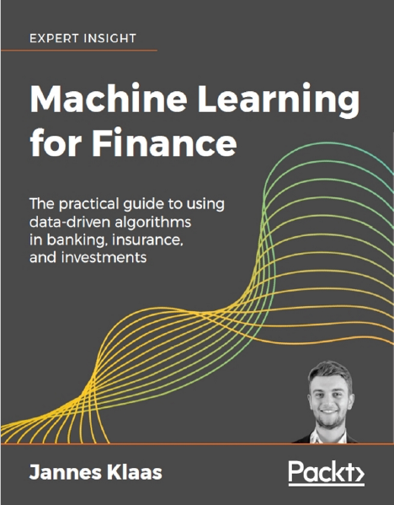
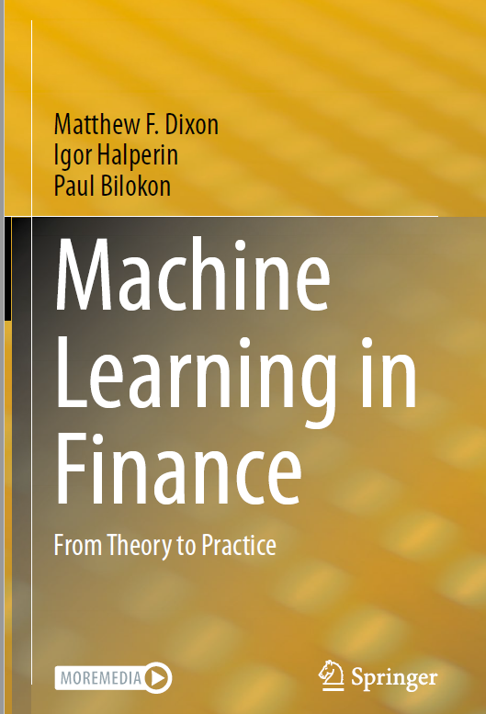
Machine Learning for Finance
Copyright © 2019 Packt Publishing
Matthew F. Dixon,Igor Halperin
Paul Bilokon
© Springer Nature Switzerland AG 2020

Slide 3
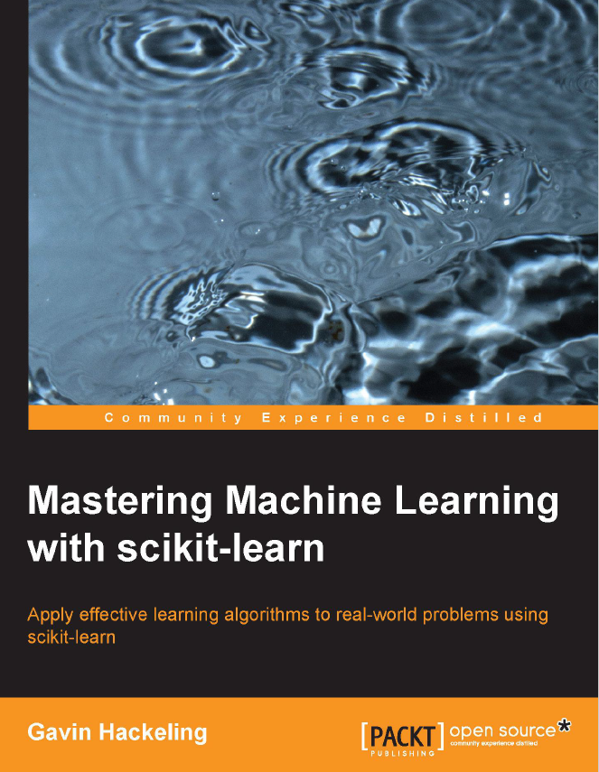
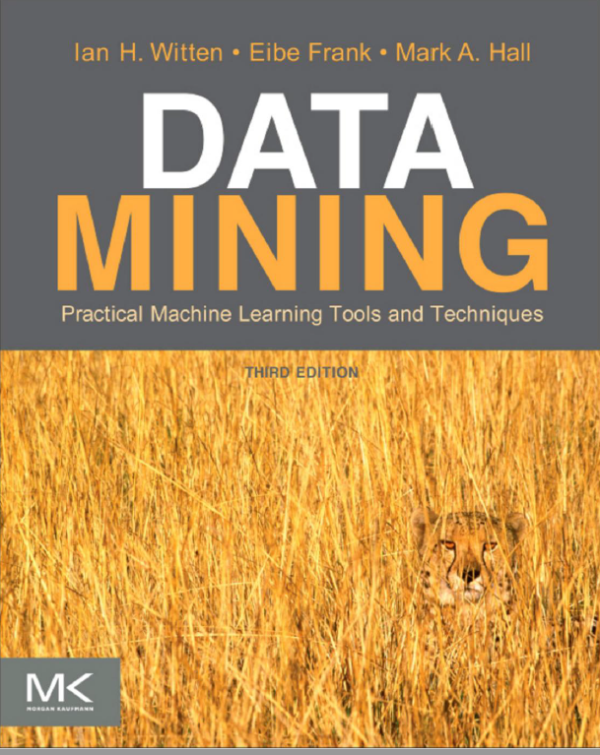
Mastering Machine Learning with scikit-learn
Copyright © 2014 Packt Publishing
Morgan Kaufmann Publishers is an imprint of Elsevier
Copyright © 2011 Elsevier Inc. All rights reserved.

Slide 4
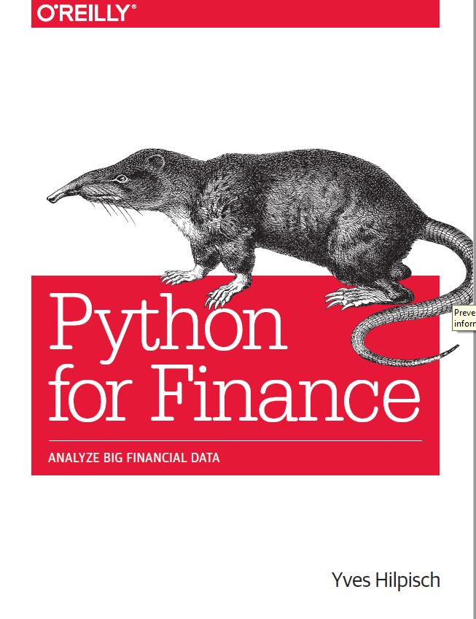
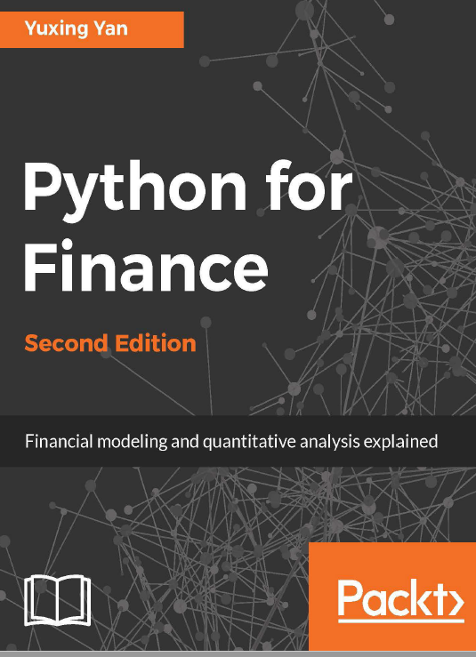
Python for Finance
by Yves Hilpisch
Copyright ⓒ 2015 Yves Hilpisch. All rights reserved.
Printed in the United States of America.
Published by O’Reilly Media, Inc., 1005 Gravenstein Highway North, Sebastopol, CA 95472.
Python for Finance
Second Edition
Copyright © 2017 Packt Publishing

Slide 5
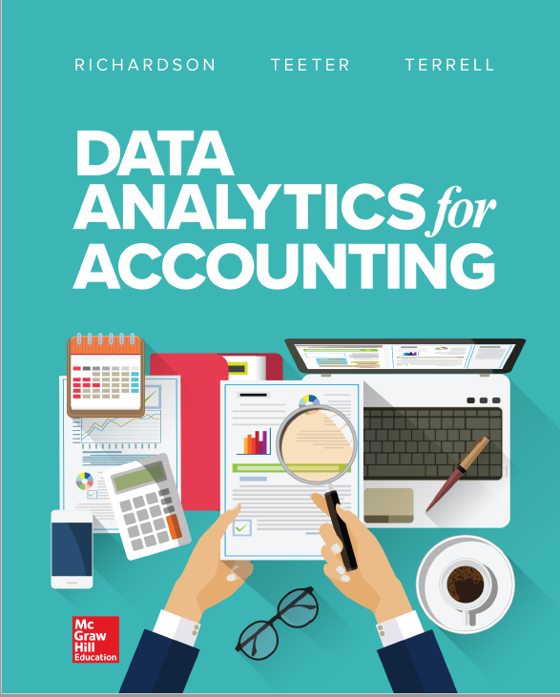
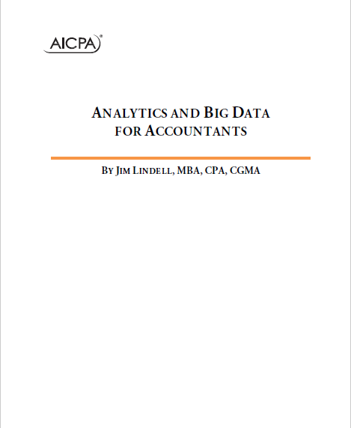
DATA ANALYTICS FOR ACCOUNTING
Published by McGraw-Hill Education, 2 Penn Plaza, New York, NY 10121. Copyright c 2019 by McGraw-Hill
© 2017 Association of International Certified Professional Accountants, Inc. All rights reserved.

